Slide 1
UNIT-IV Big Data and Application Hyper Virtualization for Instant CSPF, use Cases for Input Traffic Monitoring, Classification, and Triggered Action
SESSION 9
Ref. 2, Ch.10 (Page. 295 to Page 298)
Ref. 2, Ch.12 (Page. 321 to Page 335)

Slide 2
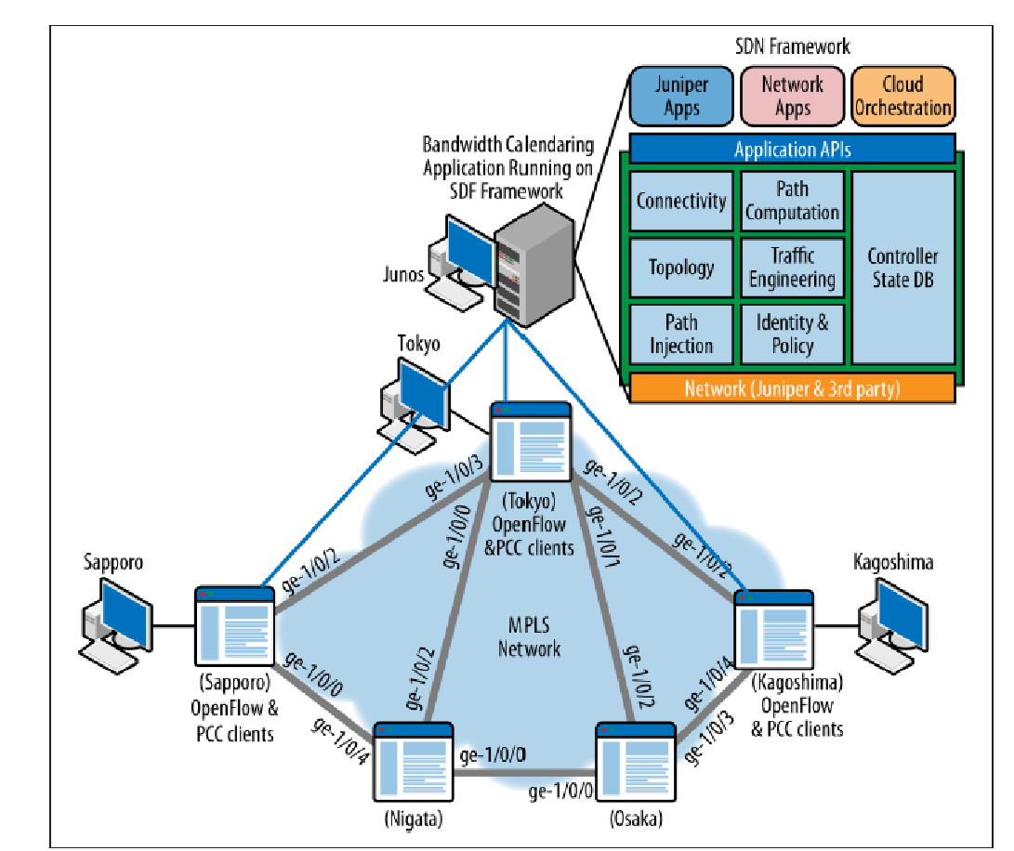
Use Cases for Bandwidth Scheduling
Bandwidth calendaring is a category of use cases1 that (at their heart) embody the concept of time-based bandwidth manipulation. In these cases, the manipulation refers to the addition, deletion, or modification of bandwidth in the network.
The reasons, or triggers, that would cause one to perform bandwidth manipulation vary widely but include modification of bandwidth characteristics to more closely match traffic patterns, service demands and disruptions, or operational planning for future changes such as capacity.
In Figure topology, there are five routers located in Japan. Each router is positioned to support multiple sites for multiple tenants of the service provider.
All five routers support both the OpenFlow protocol and MPLS/IP (to show how the solution may work with multiple different controller types).
Our Bandwidth Calendaring application runs on top of a conceptual SDN controller or framework of multiple, interchangeable controllers and other services.

Slide 3
OpenFlow and PCE Topologies
A private management LAN is implemented allowing direct Ethernet connectivity between the controller and each device in the network.
With this basic setup, paths can be established across the core of the network interconnecting the sites using a variety of methods, all of which technically can be considered SDN
Once baseline connectivity is established, reservations for specific client flows can be accepted by the calendaring application via its visualization interface or from clients passing through embedded API calls.
The most basic API call would be parameterized with a path preference (optional), a path provisioning method preference (optional), and flow information (resolvable source and destination address, flow sockets, or other match detail), bandwidth requested, flow duration, and start time (optional).
Our specific example will illustrate reservations/flows between Sapporo and Kagoshima. In particular, video client will be used on the (customer) subnet 3.3.3.0/24 in Sapporo to a video server (2.2.2.2) at the Kagoshima site. The reservation will be asymmetric (6.4 Mbps for high-definition video from the source to receiver and a 10 Kbps backchannel for video session maintenance from the receiver to the source).

Slide 4
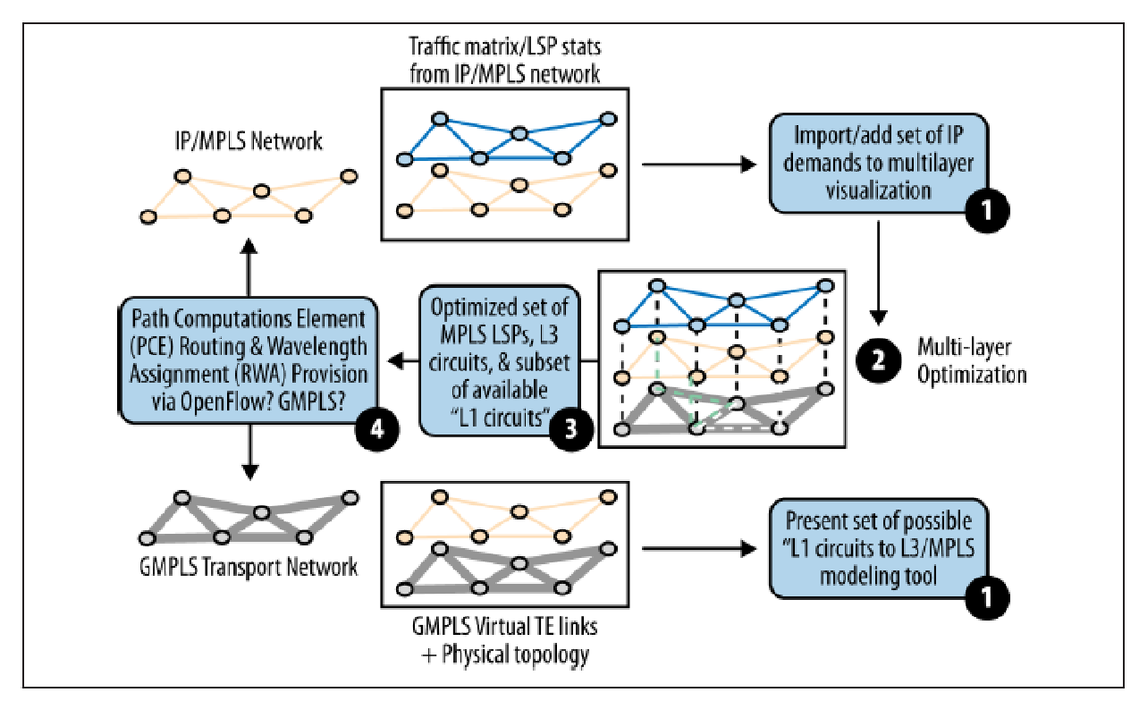
Big Data and Application Hyper-Virtualization for Instant CSPF
bandwidth calendaring use case have required a simple set of services provided from the SDN controller/framework to the application.
These focus primarily on topology, path computation, and path provisioning.
The topology is a layer 2 (OpenFlow) or layer 3/MPLS topology (PCE), and the path computation required is a relatively simple SPF (OpenFlow) or CSPF (PCE) with limited constraints (current network state, basic analytics in current flow stats and reservations, and a relatively simple, embedded policy).
Many network operators today perform periodic optimizations of their networks (or sections of their networks) using offline analytic and computation engines. These efforts are largely manual (with some potential for automation) and are limited by both the capability of the tools used and the static provisioning model (that we were working around in the bandwidth calendaring application
A predictive, multilayer topology network optimization workflow

Slide 5
The working paradigm is to ingest a static topology (depending on the tool vendor, from element configurations or routing protocol database dumps), flow data, and user defined policies or constraints (e.g., maximum path delay or avoidance of Shared Risk Link Groups) and optimize it for the most efficient network utilization (normally in both an active and limited hypothetical failure scenarios).
The result of an analytical run is normally in the form of a recommendation that’s exportable to a spreadsheet that is then converted to vendor-specific tunnel creation syntax/semantics, and provisioned during a maintenance window
The strength of current offline tools is in the variety of their parameters and policies they can incorporate and the complexity of the mathematical algorithms they use to divine a result. But, depending on the complexity and scale of the network itself (or the flow data), they currently can run for a very long period of time.
Operators would like to take advantage of the provision-analyze-optimize cycle inherent in the network control SDN promises to implement in a more dynamic/automated workflow.

Slide 6
dynamic/automated workflow
In this workflow, the path computation component could optimize based on:
Current utilization
Commonly from a flow data repository
Historical utilization
Generally a less specific graph of utilization based on historical flow data to indicate a diurnal pattern of network use (this diurnal pattern can be updated with a sliding window of historical data if there is a distinct variance in the trend)
Future reservations
Managed by the Bandwidth Calendaring reservation system These inputs will probably not be exclusive, and the real power in prognostication is derived from their combination.
Though only a potential application, SDN and big data techniques may provide viable solutions for this network optimization application, and the range of potential service demands between bandwidth calendaring and this automated network optimization (“fly-by-wire”) application accentuates the need for modularity in components and (again) flexibility in the service APIs exposed.
for example, grid computing for customized distributed summarization of analytical data and Hadoop to farm the computational exercise, and interfacing their results to a PCE server for provisioning.

Slide 7
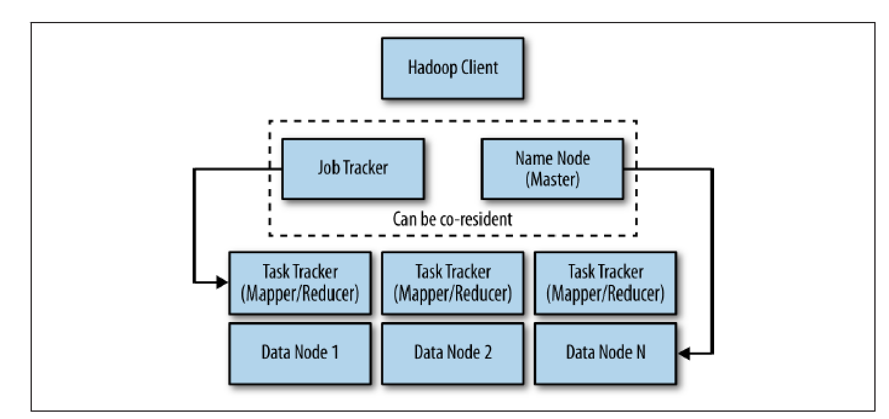
Optimized Big Data
In general, big data is not normally a virtualized environment because the hypervisor overhead is unnecessary. Hadoop is one of the most popular of a class of cluster computing architectures for big data that uses an application controller to manage job requests.
Hadoop is used for a class of applications called Map/Reduces, which process tremendous amounts of data by breaking the problem (i.e., the data set) into a number of sections/blocks, spread across a number of machines for parallel processing. This system also takes advantage of Hadoop’s distributed filesystem—HDFS
The main overhead in the application is in distributing the sectioned file, storing and then collecting the results.
The Hadoop architecture has three functional components: clients, masters, and slaves (Figure). The client is the ultimate end user of the cluster, submitting a job request with a file to manipulate with instructions on how to manipulate/process it and collecting results.
The master node in Hadoop has overall responsibility for file distribution and managing the processing nodes. It depends and interacts with two other nodes: the name node and the job tracker. The name node is responsible for the distribution/ storage, and the job tracker coordinates the compute.

Slide 8
The slaves are called the mappers and take the blocks and process them. The reducers collect and aggregate the results. The job tracker controls the task tracker process and also processes and coordinates jobs submitted by clients.
The job tracker talks to the name node to determine the location of the data being processed. The job tracker is also responsible for submitted work to the task tracker nodes that have been chosen to do the work.
As a means of redundancy and high availability of the system, the task tracker nodes must ping the job tracker at periodic intervals. If these heartbeat signals are not received after some period of time, the job tracker decides to resubmit the job elsewhere, can blacklist the task tracker, or just remember that this particular node’s performance characteristics for the future because it may only be a temporary condition.
It could also denote the start of a host/server failure.
The name node keeps a map of where the file is and to which machines the blocks are distributed. It has some level of topology awareness on its own, in that it understands the relative position of hosts by a manually configured rack number associated with the host by the administrator.
The name node then works using algorithms that try to optimally distribute the data to cut down on inter-rack transfers but still maintain separation of the replicates so that redundancy/replication can work

Slide 9
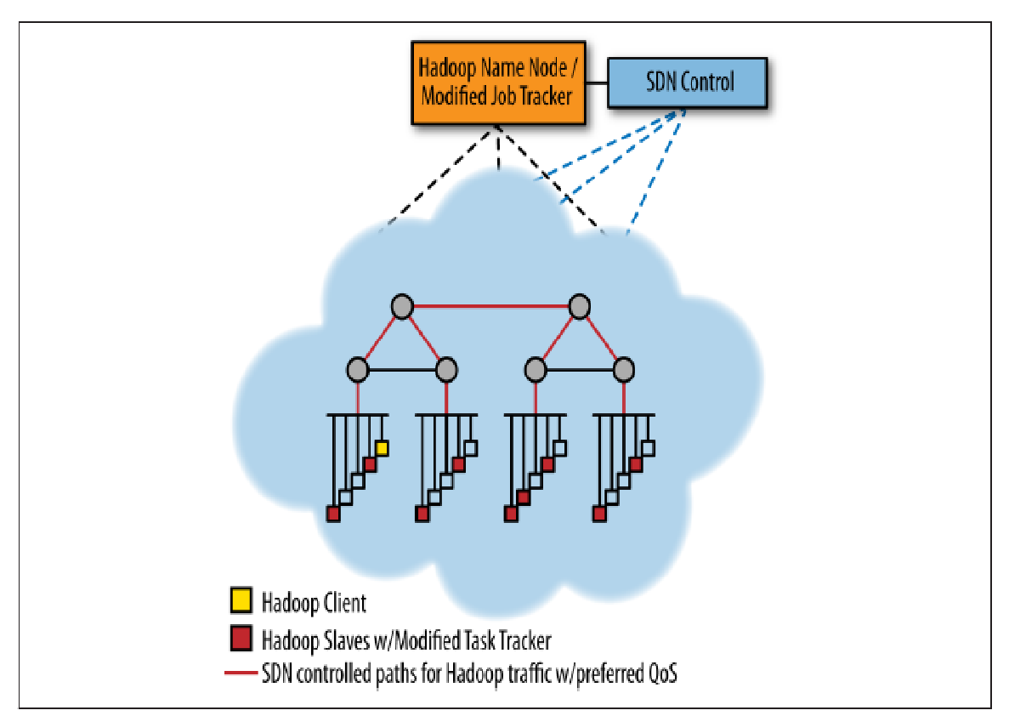
Using an SDN (OpenFlow) controller and a modified version of Hadoop (a modified job tracker and task), an alternative more dynamic version of Hadoop can be realized in a traditional switched/shared Ethernet-based topology
For example, a recent study that optimizes the shuffle phase where mappers send results to reducers by using OpenFlow-driven QoS so that the shuffle traffic can consume more link bandwidth has shown promising results
Modified Hadoop with SDN control giving Hadoop traffic favorable QoS treatment (in a generic, Ethernet-switched data center architecture)

Slide 10
Use Cases for Input Traffic Monitoring, Classification, and Triggered Actions
The general premise is one of interception or detection of some traffic pattern somewhere in the network—often at the edge or access point—that then results in one or more triggered actions. The action or actions can vary and be quite robust: from as simple as dropping incoming packets or as complex as triggering a query to a radius server or an HTTP redirection.
The Firewall:
At its heart, a firewall is a system comprised of an input traffic pattern-matching engine populated with a set of classification rules to match input traffic on. Classification rules range in capability from quite simplistic and primitive, to complex regular expressions.
In all cases, each classification rule has a corresponding action that is taken by the engine based on a positive match of the classification rule.
the basic function of a firewall is to pattern match input traffic, and take an action. The action, incidentally, can be as input to another rule, which might result in recursive or iterative rule triggers and processing.
In effect, the firewall rules become almost their own programming language.

Slide 11
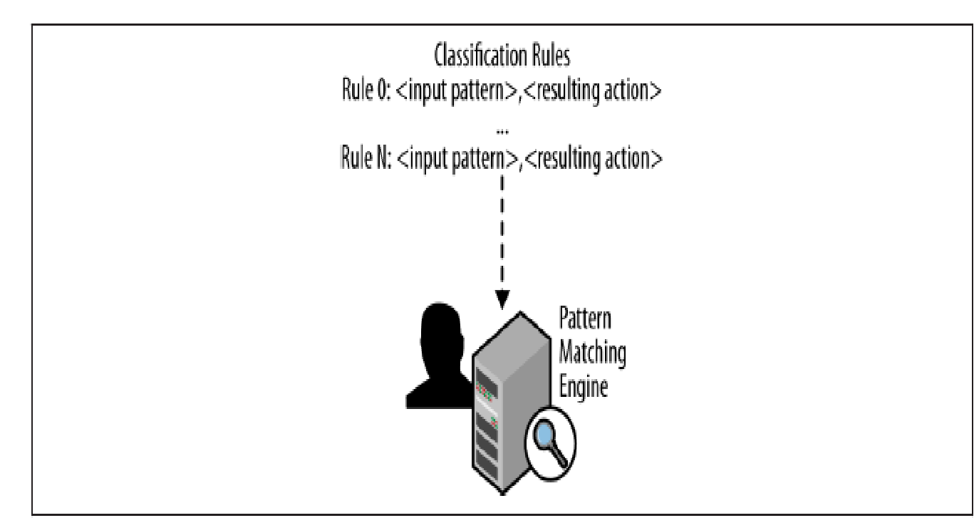
Let’s investigate how firewall classification rules can be specified, as well as the resulting actions.
As mentioned earlier, at their heart, firewall rules are a 2-tuple consisting of {<input pattern>, <action>}. A firewall typically stores the rules in an array format, numbering each rule sequentially. Figure illustrates this basic concept.
The match-action rule can be something as simple as “allow all” or “deny from any interface <n>” which would either forward any matching traffic or drop all incoming traffic on interface n, respectively. Or they can be as complex as matching multiple pattern fields within incoming packets, such as filtering on TCP port ranges, “drop from any ipv4 TCP PORT 61000:65095”.
Match-action rules can be then chained together to form more complex actions, too. For example, you could jump to a matching rule group if input traffic matched a certain pattern as in, “ACCEPT from 192.168.1.0/24 to Interface eth0 –j GOOD-DMZ”. In that example, you would jump to another set of rules defined in the “GOOD-DMZ” rule group.

Slide 12
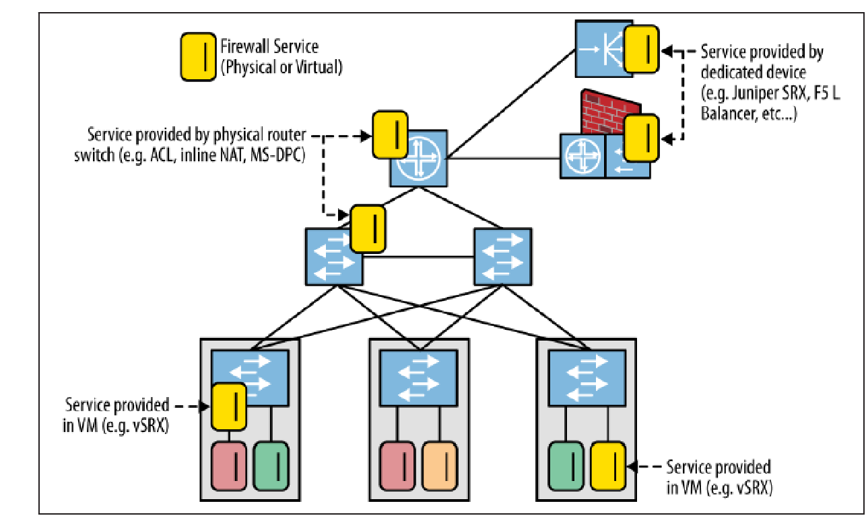
Deploying physical and virtual firewall network services
Notice the mixture of real and virtual firewall services deployed in the network.
placement of a virtual firewall on a physical system that is already well-loaded, either in terms of CPU processing or packet processing on its input interfaces, can also result in delay or even packet loss.
A final twist on the virtualization of firewall services is to add centralized control of the firewall service itself. This can be implemented as a combination of centralized control of not only the service (and the virtual machine in which it lives), but also the actual firewall rules that are used to drive the pattern matching function of the firewall.

Slide 13
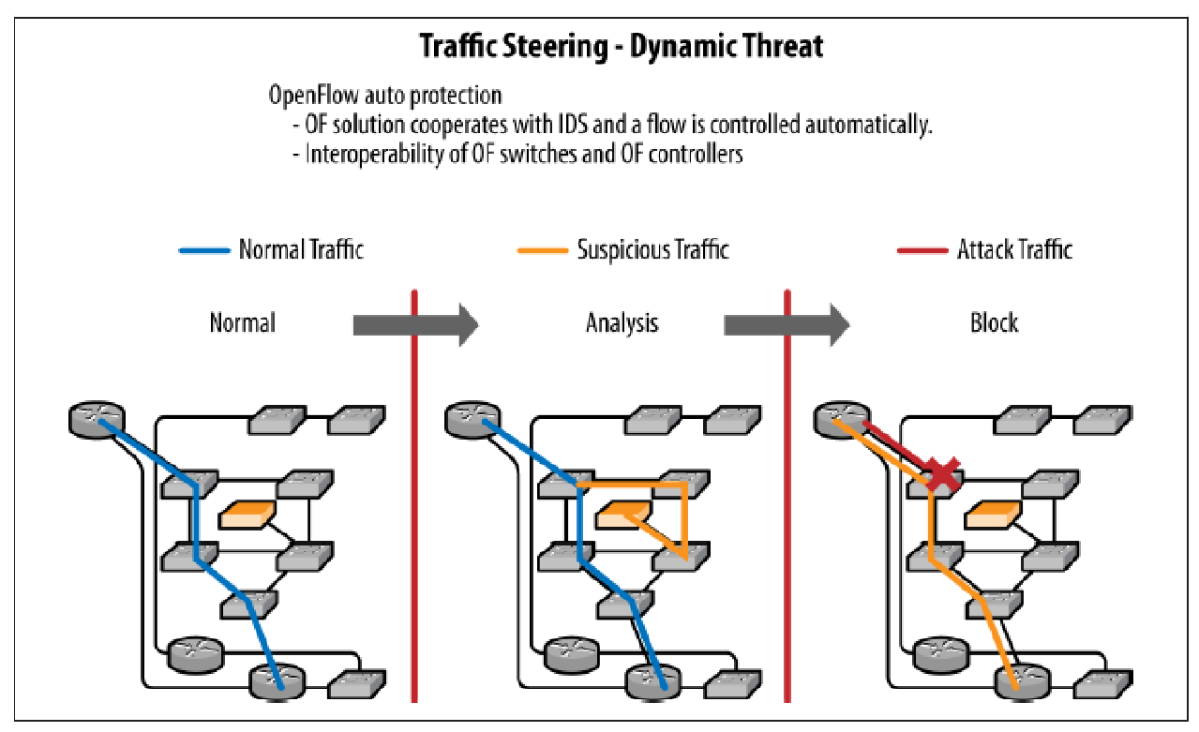
Intrusion Detection/Threat Mitigation
Generic rules that do flow forwarding based on IP source and destination prefixes.
More granular (i.e., longer match and higher preference) for specific and approved flows between these sources and destinations.
A rule handling flow misses (UNKNOWN traffic) with a rule that will create a copy of the packet using an action set like that of the tap application, and forward a miss to the IDS. The IDS software can be doing device profiling flow signature matching and other tasks.
Depending on the outcome of the analysis, a specific flow entry allowing passage of the traffic can be installed via an API call to the OpenFlow controller at the interception point or a specific flow entry. The action would be to DROP the flow.
This rule can be installed on the ingress switch(es).
Dynamic threat mitigation using OpenFlow

Slide 14
Optimally, this feedback loop would create a learning system wherever possible. It needs to do this so that default rules and policies are incremented to capture these learned behaviors.
Some of the more logic-driven aspects of intrusion detection and threat mitigation such as the logic that tracks changes in expected behavior or profiles—like when a known print device begins to initiate flows associated with a compute device, up to and including network mapping or port scanning—may be too difficult to capture in a small set of rules and thus defeat learning.
However, some degree of learning could be expected with this particular example

